Slide 1
Technology Q & A
Helpful tips on using technology

Slide 2
What is a blog?
A place online to share your own ideas or commentary with a group of followers
Notes:
Some pastors seem to have an interest in blogging. That led to a series of questions about what it is, how to do it, and where to do it.
There is no real strict definition of what makes a blog. It’s basically just a series of articles you write to share with others. Blog are less formal that magazines so your articles don’t need to be as formally structured or edited to perfection. Essentially, you have ideas you want to share, so that’s what you do.
I have a little experience with blogging. My pastor writes one—an online devotional of sorts. I started writing one a few years ago, but decided there wasn’t a big enough audience for it. So let’s find out about blogging…

Slide 3
What is a blog?
What kind of topics?
How long are the articles?
How often do I have to write?
Notes:
Topical blogs generally focus on a related set of topics. For example, you might focus on “Christian living”, or “Understanding God”. My pastor hasn’t really defined his topic, but it’s something like “Living in light of what God has promised”. People also just blog about what’s happening to them. So the first step in blogging is to pick your theme. It should be something you’re comfortable with thinking and writing about, and probably something you already think about regularly. What if I want to write about something off-topic? Well, it’s your blog, so you can really write about anything you want. But think about it before you do. In a blog that talks mostly about Understanding God, does your love for peanut butter and jelly really fit well? And would it be of interest to your audience? I know you can’t always tell for sure, but if you take a moment to evaluate, some ideas pretty clearly don’t fit and others it’s more about your conviction for it than anything.
People’s attention spans are pretty short. I’d recommend keeping your blog posts short and to the point—mostly to the point. Some thoughts require more words than others and you can certainly vary the length based on what you have to say. It’s good to break it up into shorter paragraphs as that makes it easier for an online reader to follow it.
Pick a frequency you can handle. If you love writing every day, there’s nothing wrong with doing that. I’m too busy for that myself and wouldn’t have something new to say every day. My pastor does his twice a month. If he could sit down and talk to a camera for 5 minutes, he’d probably do it more often. And that’s certainly a valid way to do a blog—it doesn’t have to be words. For an online blog, it needs to be “new” often enough that people in your audience get used to coming to read it. Monthly or every other month may not be enough to get people interested.

Slide 4
Blogging
Who is going to read this?
Notes:
Building an audience can be the most challenging thing about blogging. Just because you write something doesn’t mean people are going to find it and read it. As a pastor, you already have a ready-made audience in your church and extended acquaintances. You can use that to kickstart your audience. My pastor emails his blog posts in addition to posting them online. When you do that, include a link to your online blog so if someone forwards it to a friend or relative, they can continue reading online if they want. Tell people you talk to that you write a blog. Some will be interested. We also post links to the articles on our church’s Facebook page. And you can share it on your own Facebook timeline. Every place you share the links to the articles help increase your audience.

Slide 5
Blogging
Where do I blog?
Notes:
Probably the number one question I get about blogging is where do I recommend you do it. I always give the same answer, and it’s almost always met with resistance and skepticism. So here goes: You should blog on your church website. Why? (1) your website already has an audience (2) new content on your website will help drive traffic there which means more people may discover your church.
So why wouldn’t you want to blog on your website? Maybe it would be best not to if your blog topic isn’t related to Christian life. Or if your website still uses the old static html setup so that you simply can’t easily use it to blog.
WordPress, which we recommend as a great platform for local church websites was originally designed as blogging software, so it is extremely well-fit for blogging. WordPress can handle multiple users, so your local church webmaster can continue to maintain the website while you write your own blog section of it.
If you really don’t want to do it on your website, blogger.com and wordpress.com both offer free blogging space. The bigger challenge when your blog isn’t connected to your website is building the audience. And once you have the audience, how do you connect them back to your church?

Slide 6
Blogging
Comments and discussion
Notes:
Generally-speaking, comments are allowed in a blog. Allowing the public to comment on your posts encourages open conversation. I would recommend that you moderate the comments to prevent both spam and “flaming”. Flaming is posting negative reactions that have no purpose other than to upset the reader. Will you get spam if you allow comments? Probably. It’s almost impossible to prevent all of it. But in our standard setup, we use two WordPress plugins to reduce spam, and add a third if that is not enough. Even with three filters, some will get through from time to time.
How much discussion will you have? It varies widely and depends on your audience. We have almost none on our pastor’s blog. But others get regular feedback, even some that need responses. It likely won’t eat up a lot of your time.

Slide 7
Downloading from YouTube
YTDdownloader.com
Notes:
You may find things on YouTube that you want to play at church from time to time. It’s fairly easy to download the video and use it on PowerPoint. So lets go through the process, starting with getting the software to do it.

Slide 8
Downloading from YouTube
Uncheck extras when you install
Notes:
YTD Downloader, along with many other free programs, sells advertising in its installer. This lets other parties put extra stuff on your computer that you probably don’t want. In this case, the Spigot toolbar. Just uncheck all three boxes when you run the installer.

Slide 9
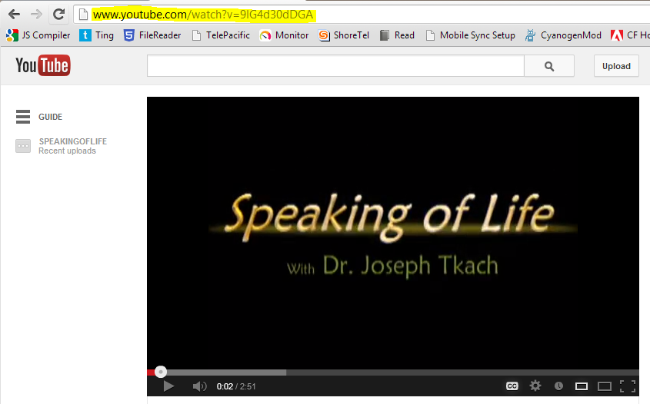
Downloading from YouTube
Notes:
First step is to get the YouTube URL. In the address box use your mouse to select the URL—highlighted in yellow on the screen. Then hold down CTRL and press C to copy it.

Slide 10
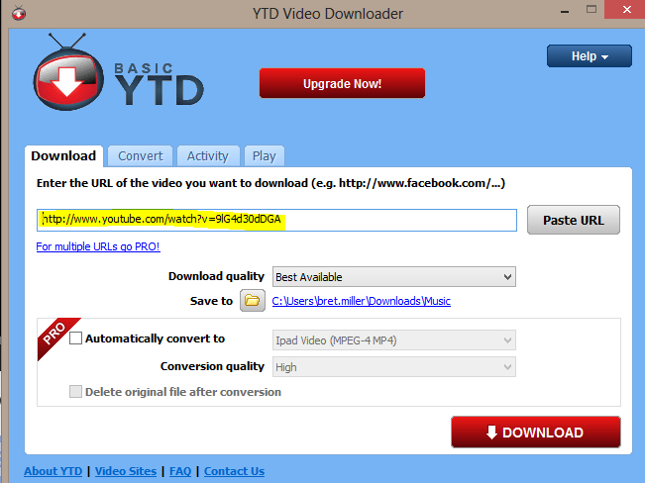
Downloading from YouTube
Notes:
Just putting your mouse over the URL box, fills it with what you just copied. Or you can press Paste URL if you need to. Note, and change if necessary, where it is saving the download. Then click the red Download button.

Slide 11
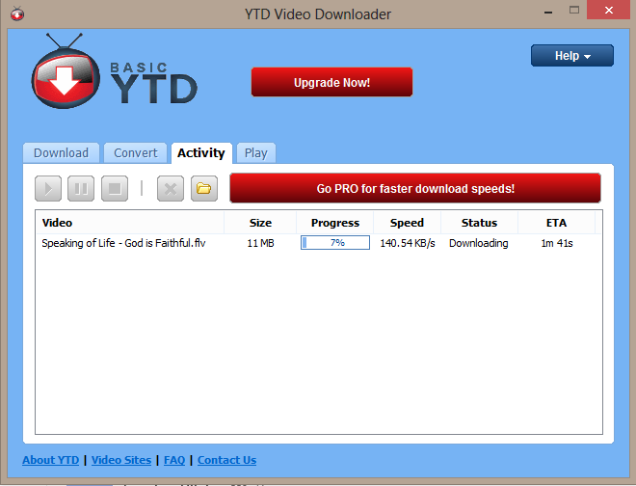
Downloading from YouTube
Notes:
Once you click download, it switches automatically to the Activity tab where you can watch the progress bar go across. Once it’s downloaded you can look at the file type to see whether you need to convert it. If you got a .mp4 file and you have Windows 7 or 8, you can use the file directly in PowerPoint. If you got a .flv file or have an older version of Windows, you’ll need to convert it.
There are better converters

Slide 12
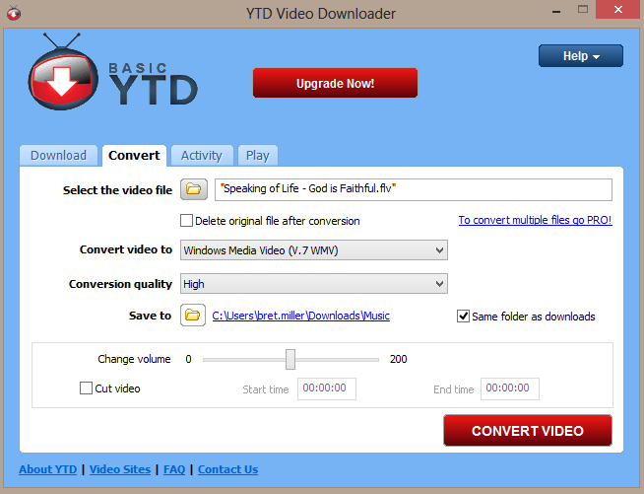
Downloading from YouTube
Notes:
So click the convert tab, find the video file you downloaded. Convert it to Windows Media Video—that works in PowerPoint no matter your Windows version. It should default to high quality and the same folder. So click the Convert Video button and watch the progress bar again.

Slide 13
Using the video
Insert > Video
Notes:
Of course, inserting the video varies from version to version. Start by clicking insert (which might be a tab on the ribbon), then click Video, then “on my pc” or “from file”. Find the file and insert it. In older versions, this creates a link to the file. In newer versions, it defaults to including the video in your PowerPoint file and you have the option of changing that at the time you insert the video. PowerPoint may ask whether to start the video automatically on “on click”. I generally like mine to start as soon as I get to the slide it’s on, but it’s your choice. If you opt for the “on click” method, you’ll see a black screen and can click to start the video. In newer versions of PowerPoint, you can select the video with your mouse and go to the Playback tab to choose how it starts.
Once the video is inserted, you can drag the edges to cover the whole slide you’re on so that it runs as full screen as it can.

Slide 14
Social Media
Facebook
Twitter
Instagram
Pinterest
Notes:
Social media is popular. No denying that. So, what’s it about? What can I do with it? Should I be using it? Should my church be using it? Can it benefit my church? Can I stop people from posting negative comments? Can I stop people from posting at all?
I, and my church, have accounts on Facebook, twitter, pinterest and Google+. We don’t have Instagram. I’ll tell you why when we get there.

Slide 15
Facebook
A place for friends to keep in touch
Notes:
Originally Facebook was created to help university students get to know each other. It has expanded so that it is now open to anyone 13 and over and allows businesses and celebrities to create fan pages where people can “keep in touch” with the business or celebrity, and event pages where you can invite all your friends to your events.
As your list of “friends” on Facebook grows, it can be overwhelming trying to keep up on everything they are all saying. So Facebook now allows you to organize your friends into groups where you can keep up with those you consider “more important” and occasionally check-in with the others.

Slide 16
Facebook
Account for you
Page for your church
Events to invite people to
Notes:
All social networking requires time. Unlike a website, you can’t just create it and expect it to do the job on its own. The social aspect requires interaction. If you don’t have a Facebook account, you’ll need one—you can’t just create one for your church. Then you’ll need to build your friends list by finding people you know and adding them as friends.
Creating a page for your church is fairly easy. But you should put some thought into it as well, The description, for example, should be consistent with the message on your website. Then it’s matter of building the audience by inviting your friends to like the page, telling people at church and other people who might be interested about it so they too can like the page. The larger the audience, the more it helps your church.
Once you have page, what do you do with it? We post links to our pastor’s blog posts, occasionally a sermon link. Our pastor semi-regularly texts members to encourage them to come to church. I tend to rewrite his content and post it on Facebook too. When we have a really awesome worship service, we’ll post a short statement about it. We’ll post invites and short recaps of events. We’ll post pictures of events sometimes. It all just serves to help keep people connected with the church.

Slide 17
Twitter
Tweet, tweet
Notes:
You can think of twitter as texting for the computer. Except that it’s like you’re texting to the whole world at once. The problem with twitter is the same as with any other social network—you need an audience. With twitter, you simply text short messages to your audience.
I have a twitter account. My church does too. I’m not a serious user of twitter though, and the church account simply tweets whatever we post on facebook. Our demographic doesn’t lend itself to twitter. Very few of our members have accounts. Fewer yet see the point, and that’s why it doesn’t get so much attention.

Slide 18
Instagram
All about the pictures
Notes:
Instagram is a place to post and comment on pictures. The catch is that you need an apple or android mobile device to use it. I’d probably have an account there, but my Windows Phone isn’t supported and neither are computers. Instagram can be linked to facebook, twitter and some other services to share your photos and videos to a wider audience. I’d love to tell you more, but I can’t access it…

Slide 19
Pinterest
More photo-sharing
Notes:
Pinterest is a very strange anomaly. Generally social networks start with the younger generation, but this one started with middle-aged housewives. You use Pinterest by organizing pinned images into categories like events, interests, and hobbies. As with other social networks, you can “follow” other people and people can follow you. Images become popular by other people re-pinning or liking them. As with all social networks, it takes a time investment.

Slide 20
Google+
Like Facebook
Circles
Hangouts
Notes:
Google+ is conceptually a lot like Facebook. To use it, you need an account for yourself. You can also create business pages like one for your church. Google+ pioneered the ability to organize your friends into what they call circles. Facebook basically copied the concept shortly thereafter. Google+ has “hangouts”, which are a lot like the old-style chat rooms. You can create a hangout, invite your friends and chat in real-time with text, audio and/or video. In that way it has more advanced features than Facebook.
The problem with Google+ is that everyone is already comfortable with Facebook and like the old phone company competition, better and cheaper are not always enough to woo people away from comfortable. It does have its place though. Google’s search engine gives extra points to your website if the pages are authored by someone on Google+, so it’s another way to increase your search placement and traffic.
But except for special things like that and hangouts, the popularity of Google+ doesn’t generally warrant a lot of time and attention. Of course, like with any social network, there are exceptions. If you find your church and extended contacts are really into Google+, it may well be a good time investment.

Slide 21
Social Networking
Time investment is essential
Moderation is the key
Notes:
All social networking requires activity. If you start a page for your church and you post once every six months, your audience won’t grow and you’ve pretty much wasted your time. On the other hand, activity can be overwhelming too. I think very few people care what or where you’re eating for breakfast, lunch or dinner most of the time, and if you share something 20 times a day, you’ll probably get put in a group that gets watched rarely. Somewhere there’s an ideal frequency where it remains interesting and helps people connect without overwhelming them.

Slide 22
Contact Info
Bret Miller
bret.miller@gci.org
churchtech.gci.org

